Slide 1
MCP201 Project.
Lê Nguyễn Đức Hùng SE210311
Đoàn vương bảo long se211414

Slide 2

Problem
People have need to travel and often time, a trip can take several days.
Pet is top concern, as there is no reason for a pet to just starve to death because owner want to go on a trip.
Thus need for an automatic fish feeder.

Slide 3
Conceived solution
Our team set out to create an automatic fish feeder using Esp32-s, bluepill, l9110, A3144, magnetic cube, motor to allow for a complete smooth operation cycle.
And also a stand-alone version without bluepill.

Slide 4
Why choose?
Esp32-S is pretty versatile, it is an independent development board with its own wifi module, I simply is trying to take advantage of the wifi module here.
Bluepill is cheap, so is the knock-off ST-Link usb. It have limited processing power
L9110 can safely control a flow of 5ohm, to use 1n4447 or 2A2222 on a breadboard bring many point of failure that can mess the entire device.

Slide 5
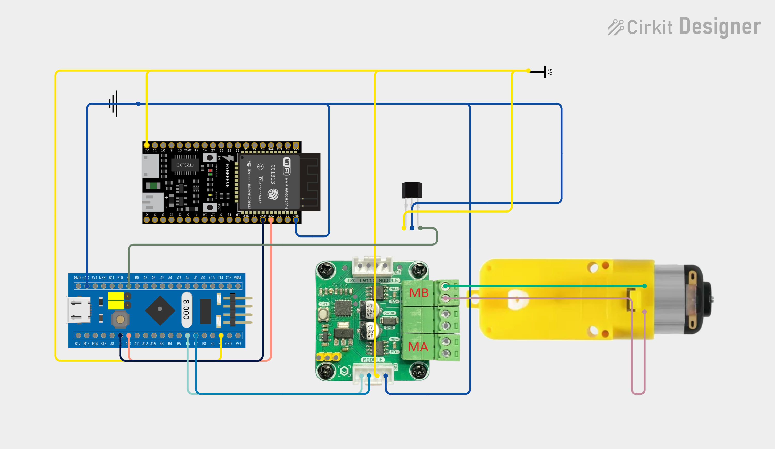
Wirng & Layout

Slide 6
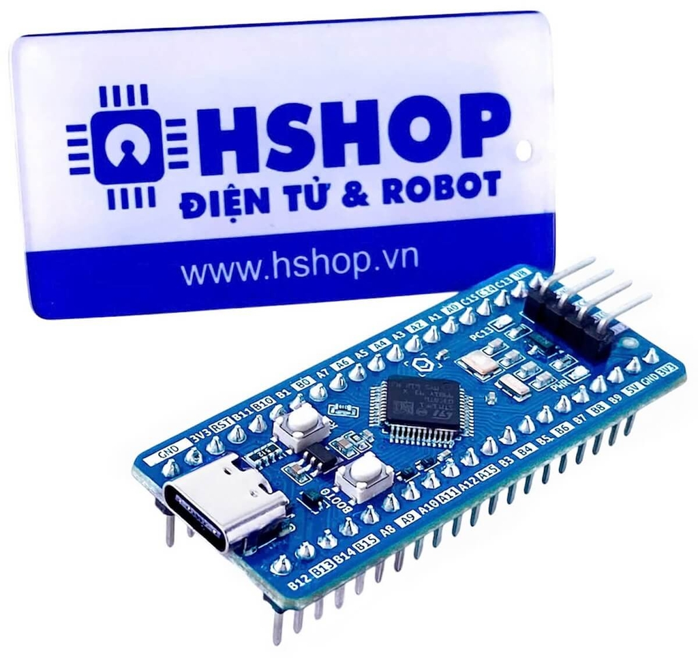
BLUEPILL
Runs the schedule and the feeding cycle
Receives the time from the ESP32 over UART
Compares the time with the feeding schedule every 5 minutes
Window: a check that falls within 10 minutes of the feed time (e.g. 8:00) triggers a feed
Feed cycle: start motor, wait for the A3144, stop motor, then a 10-minute rest before the 5-minute checks resume
Talks to the MKE-M17 over I2C. It never drives the motor directly

Slide 7
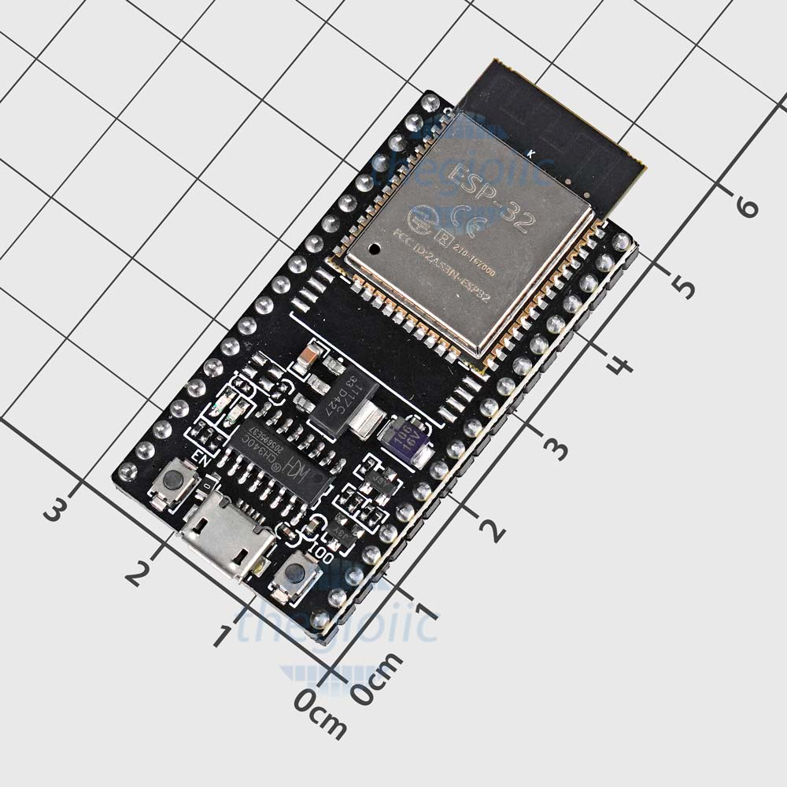
ESP32
Connects to Wi-Fi and fetches the time from an NTP server
Sends the time to the Blue Pill over UART every 5 minutes
Timezone is set in the code (gmtOffset_sec, e.g. 7 * 3600 for UTC+7)
Does nothing else: no schedule, no motor control
UART wiring: TX to RX, RX to TX, shared ground, both sides 3.3 V logic

Slide 8
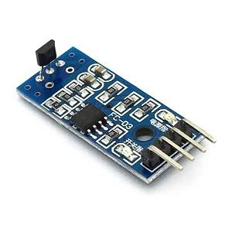
A3144
Detects the magnetic field from the magnet cube on the blade edge
The magnet passes the sensor once per rotation, which means one portion has dropped
The sensor’s output changes, the Blue Pill sees it, and the motor is stopped
Digital on/off sensor. It only responds to one magnet pole, so orientation matters

Slide 9
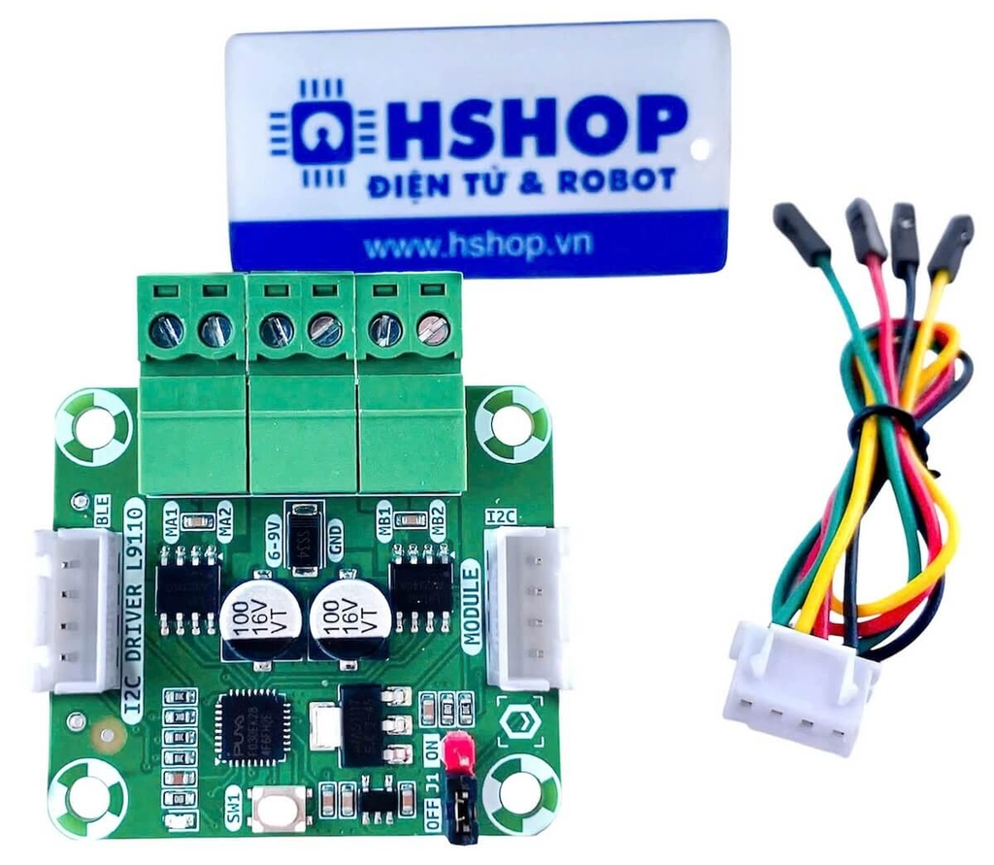
L9110
Two L9110 H-bridges, so two motor channels. This build uses one
Has its own 32-bit ARM Cortex-M0+ for PWM, direction, timing and supply monitoring
I2C control, default address 0x40
Rated 0.8 A continuous and 1.5 A peak per channel, with reverse-polarity protection (SS34 diode)
Speed set by PWM from 0 to 255
Timed run: the board stops the motor by itself when the time runs out
The Blue Pill sends commands and never carries motor current

Slide 10
VARIANT B: ESP32-S ONLY
Before (Version A): ESP32 gets the time, then UART, then the Blue Pill runs everything
After (Version B): one ESP32 does everything. The Blue Pill and the UART link are removed
Same motor, driver, sensor and mechanism
New in B: the A3144 goes to an ESP32 GPIO with an interrupt, and the schedule runs on the ESP32
New in B: a saved per-slot record replaces the 10-minute rest
New in B: a 10-hour fallback countdown if the time source is unavailable
Trade-off: fewer parts and no UART, but Wi-Fi and motor control now share one chip and one supply

Slide 11
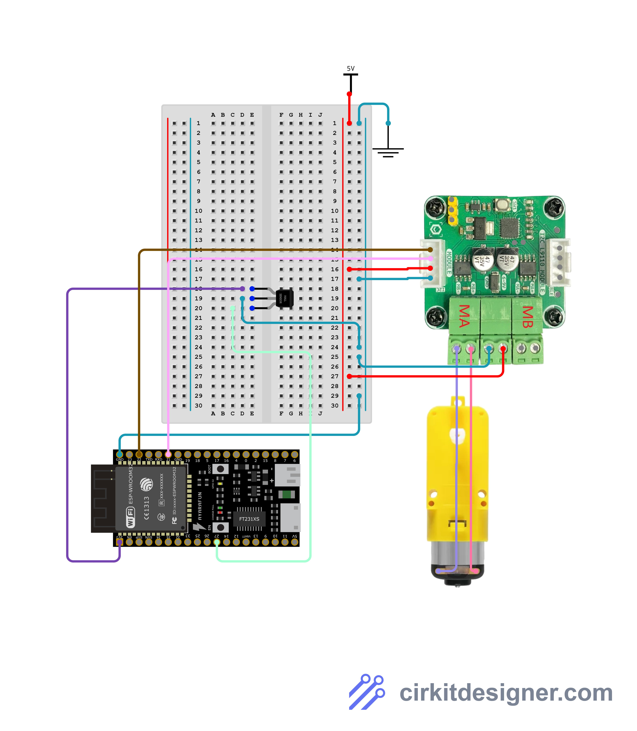
VARIANT B: ESP32-S ONLY

Slide 12
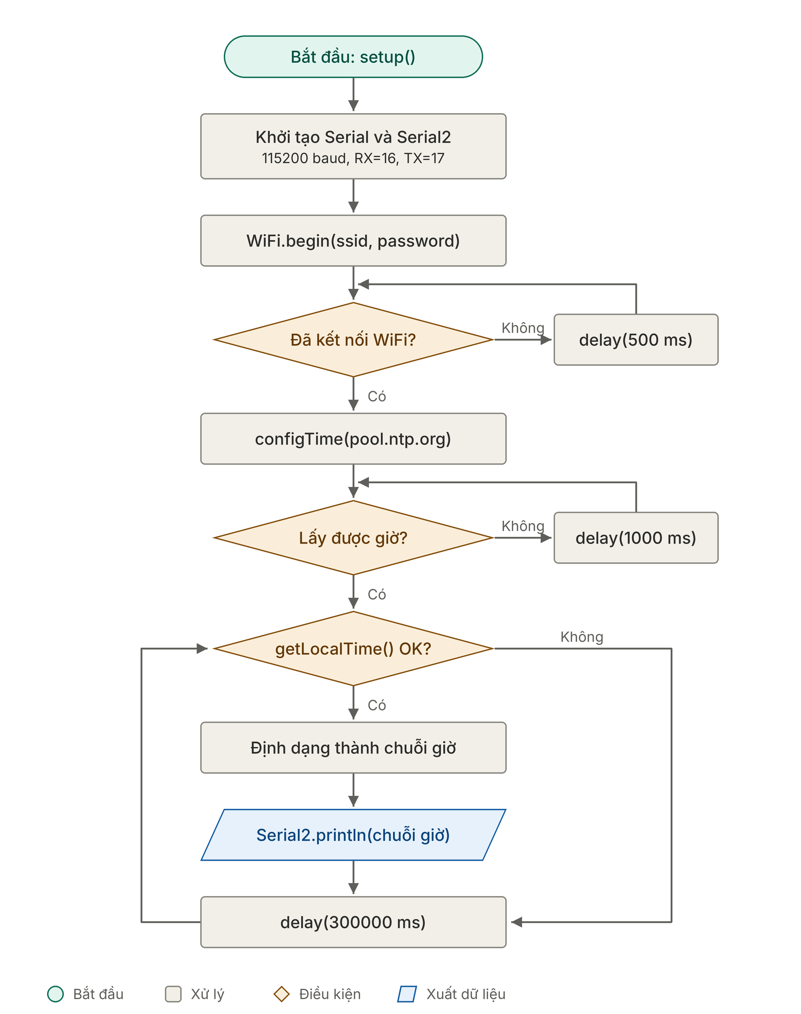
Flow of logic

Slide 13
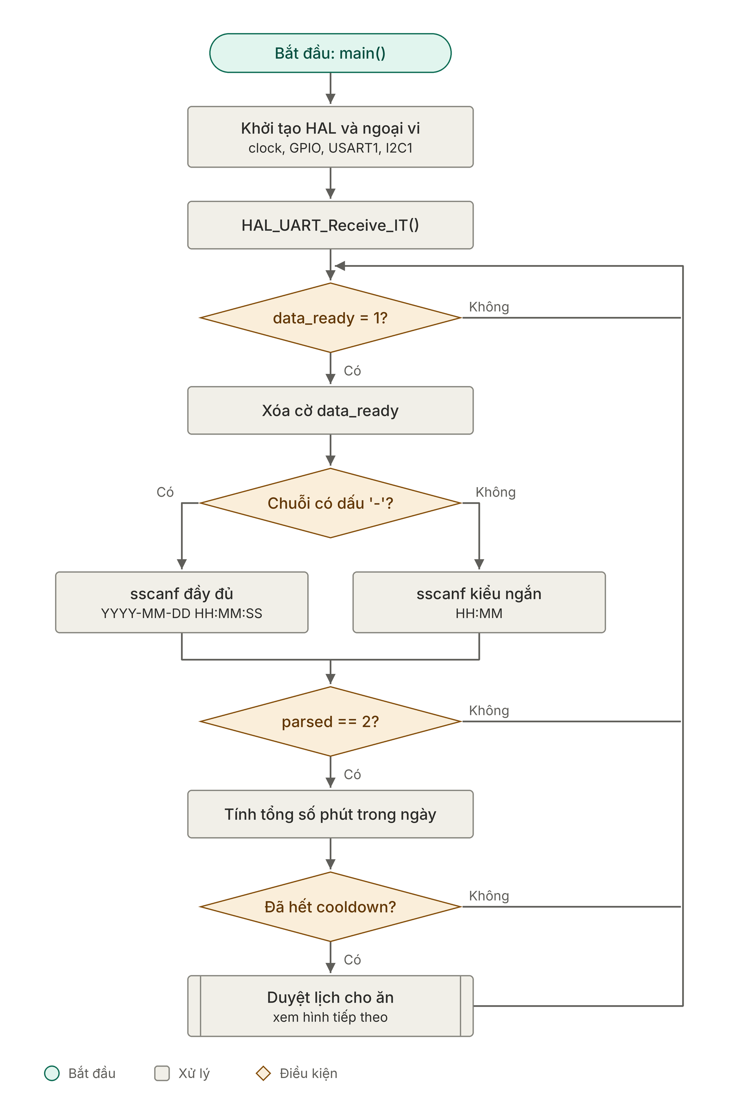
Flow of logic

Slide 14
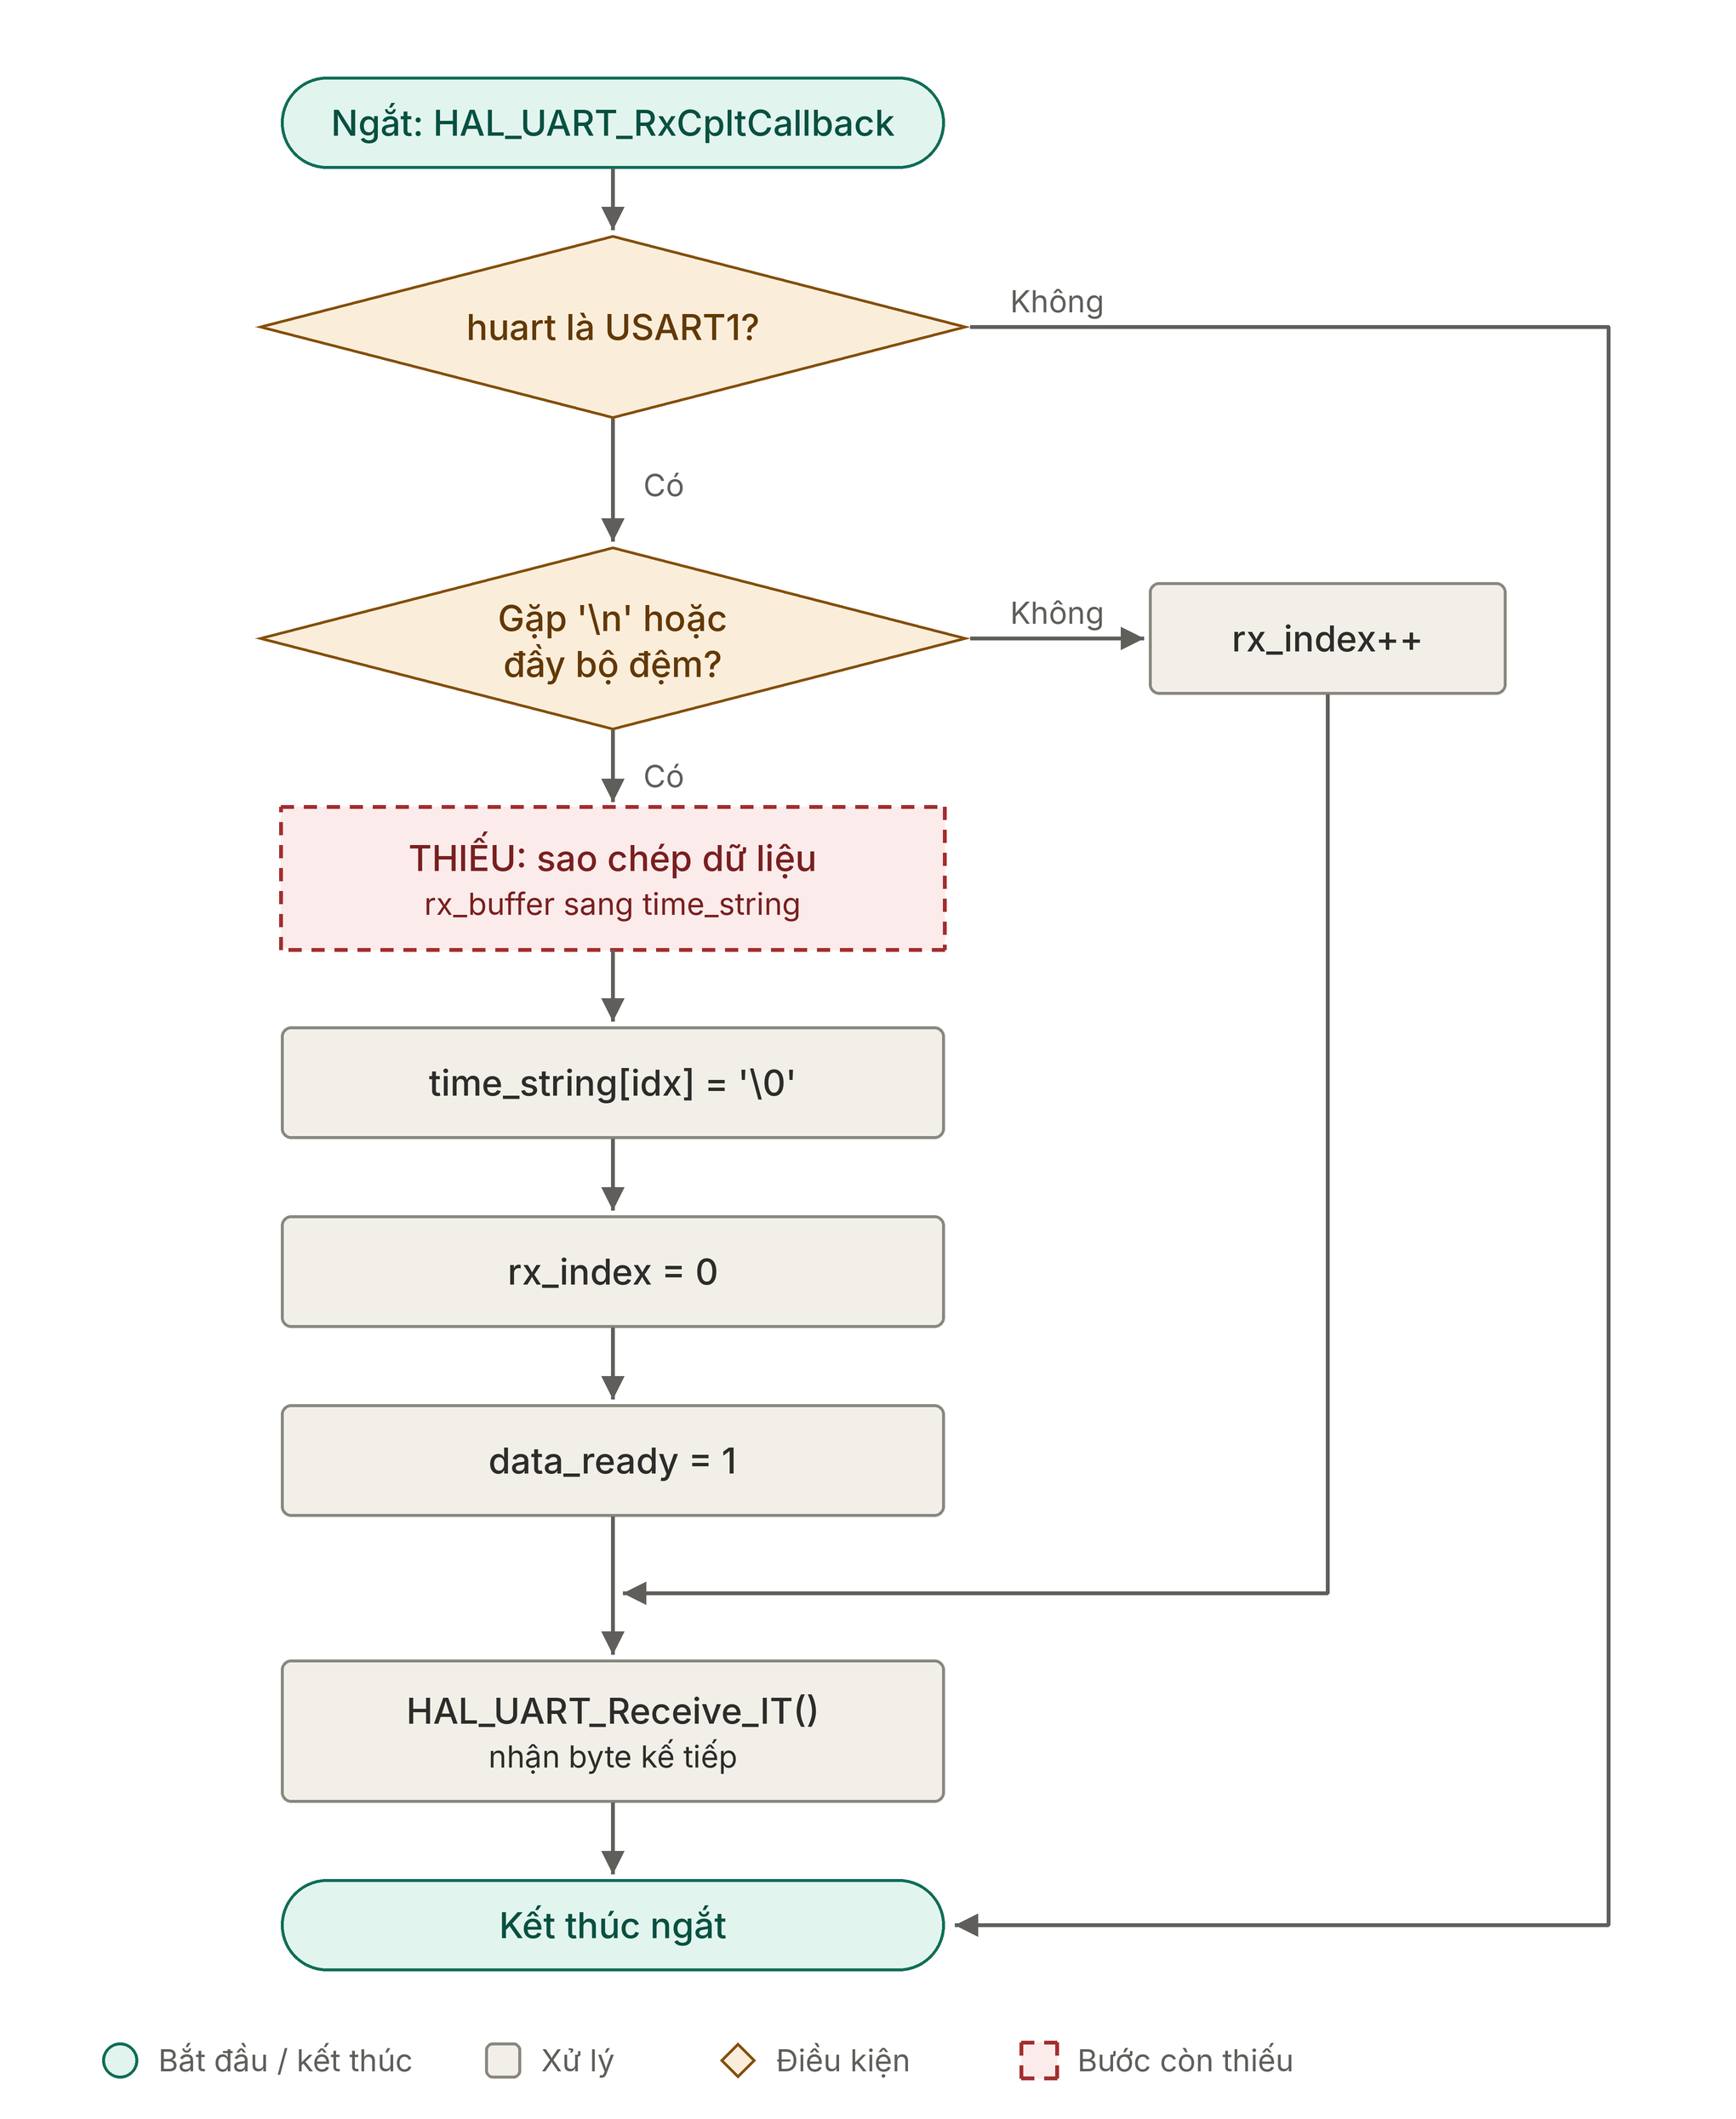
Flow of logic

Slide 15
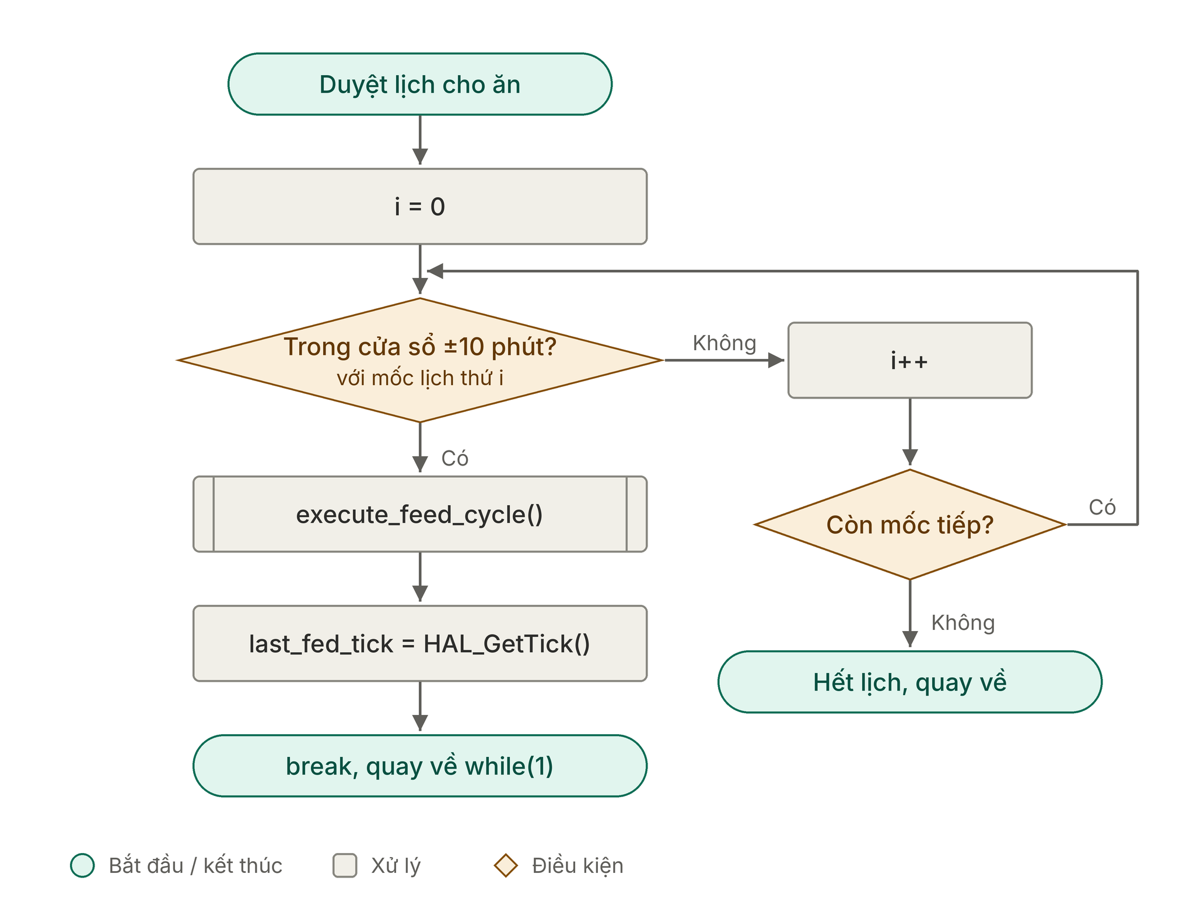
Flow of logic

Slide 16
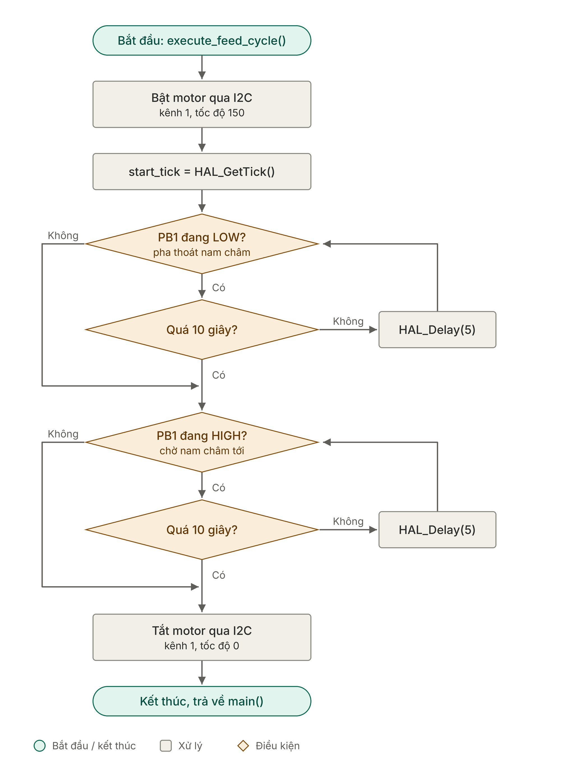
Flow of logic

Slide 17
Q&a

Slide 18
End of presentation

